Slide 1

Distributed OS Manager: Control Your Network from Anywhere
Group 19:
Lakshmi Siva Kanth Reddy Kondamadugula - A04327619
Jobit Jose - A04328225
Chandrahaas Reddy Guntaka - A04328583

Slide 2

Table of Contents
Distributed System- Introduction
Distributed System- Example
Advantages of DS
Disadvantages of DS
Examples of DS
Project Objective
System Architecture
Technology Stack
Flowchart
Challenges and Solutions

Slide 3

Distributed Systems
A distributed system is simply any environment where multiple computers or devices are working on a variety of tasks and components, all spread across a network.
Distributed systems are used when a workload is too great for a single computer or device to handle.
The hope is that together, the system can maximize resources and information while preventing failures, as if one system fails, it won't affect the availability of the service.

Slide 4

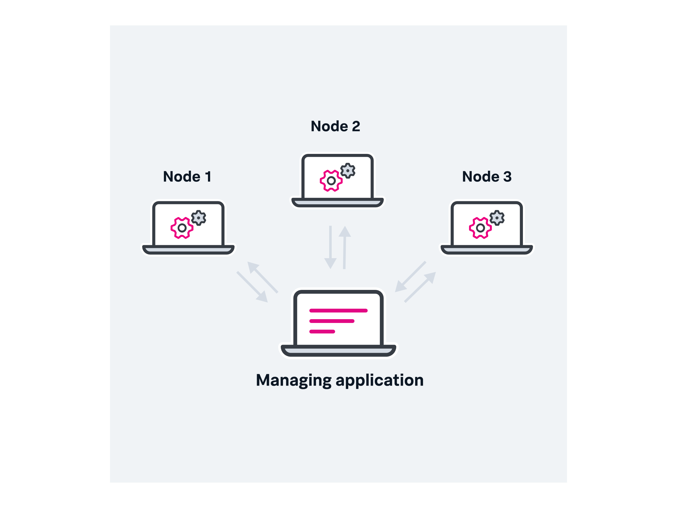
Distributed System: Example

Slide 5

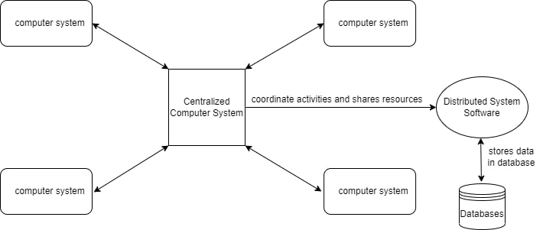
Continues…

Slide 6

Advantages
Better Performance
Cost Effectivity
Efficiency
Scalability
Reliability
Fault Tolerance
Security

Slide 7
Disadvantages
Compatibility
Startup Cost
Overheads
Network Dependency

Slide 8

Examples of Distributed Applications
Banking applications
Stock exchange applications
Web browsers
Streaming services
Rideshare applications
Food delivery applications
Massively multiplayer online games

Slide 9

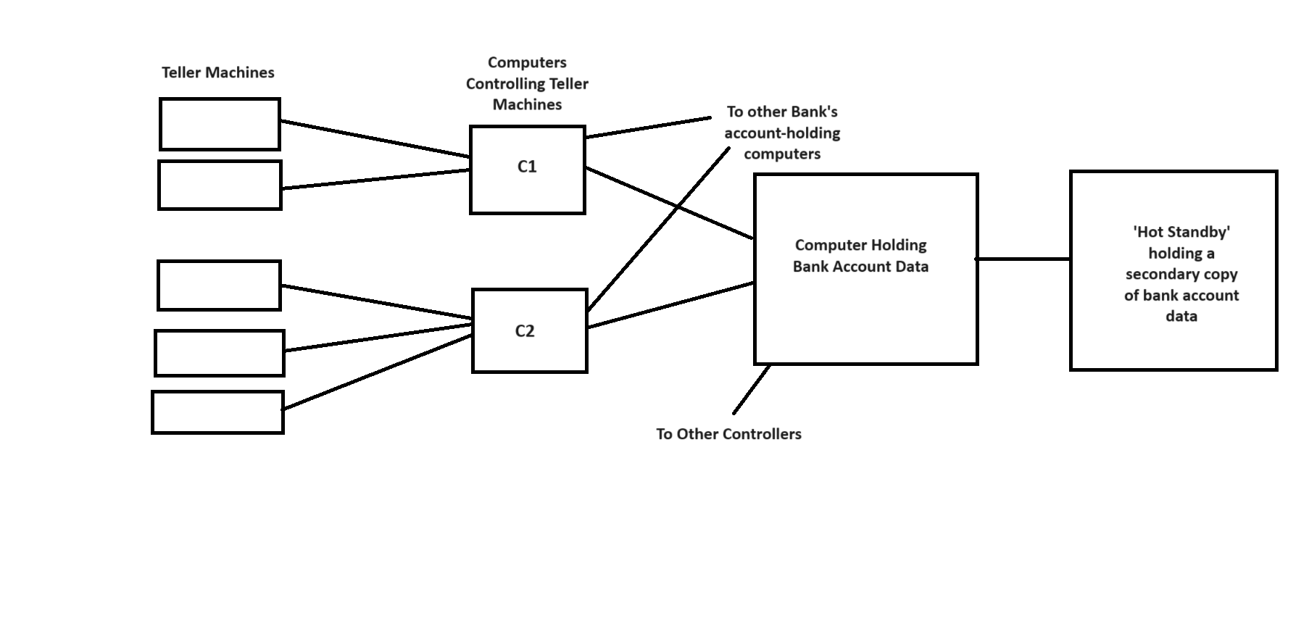
ATM

Slide 10

Objective
Develop a Web-Based Remote Control System: Design and implement a web application that enables users to control and manage nodes in a distributed system. The project leverages distributed system principles to demonstrate seamless real-time interaction, focusing on user-friendly interfaces, secure communication, and efficient data handling. This system aims to streamline operations and maintenance tasks that require managing the nodes, suitable for various applications.

Slide 11
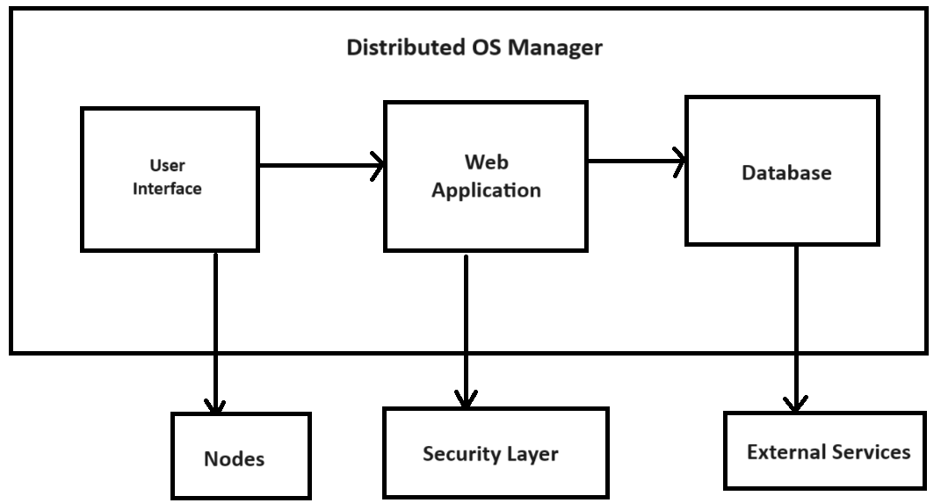
System Architecture

Slide 12

Technology Stack
Database - NoSQL
Hosting – Firebase
Front End & Back End - Flutter

Slide 13

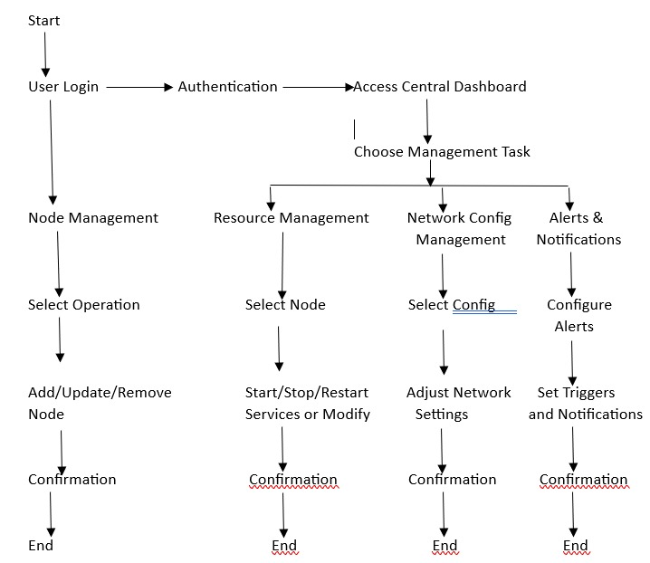
Flow Chart

Slide 14
Challenges and Solutions
Scalability
Real-Time Data Management
Maintenance and Updates
Use a database solution that scales automatically to handle increased loads and data volume.
Implement caching mechanisms to reduce database load and improve response times.
Use automated tools for deploying updates to reduce downtime and human error.

Slide 15


